Slide 1
SEMI SUPERVISED LEARNING
PARTICIPANTS: DHEERAJ NAGURU
RIDHIMA CHEBOLU
ROHITH SHASHI

Slide 2
TABLE OF CONTENT
INTRODUCTION
DIFFERENT SEMI SUPERVISED LEARNING METHODS
TWITTER SENTIMENT ANALYSIS
DATA PRE-PROCESSING
SELF LEARNING
COMPARISON WITH SUPERVISED AND UNSUPERVISED LEARNING
CONCLUSION

Slide 3
INTRODUCTION
LARGE AMOUNT OF DATA
SUPERVISED LEARNING : Labelling all the data
UNSUPERVISED LEARNING : Use of Unlabeled Data
SEMI SUPERVISED LEARNING : Supervised Learning + Unsupervised Learning

Slide 4
SEMI SUPERVISED LEARNING METHODS
SELF TRAINING : Use of Pseudo Labelling Data.
GENERATIVE MIXTURE MODELS : Use of only one labelled example per component.
CO-TRAINING : Each classifier classifies the unlabelled data and teaches the other classifier with the few unlabelled examples.
TRANSDUCTIVE SVM : Use of Hyperplane to maximize the margin.
GRAPH BASED MODEL : Aims to classify unLABELLED data by learning the graph structure and LABELLED data jointly.

Slide 5
TWITTER SENTIMENT ANALYSIS
PROVIDES INSIGHTS ON USER SENTIMENTS
TWITTER HAS LARGE AMOUNT OF DATA
NOT PRACTICAL TO LABEL ALL TWEETS
USE OF UNLABELLED TWEETS FOR MODEL TRAINING
SELF TRAINED SENTIMENT ANALYSIS

Slide 6
DATA PRE-PROCESSING
DATA CLEANING
REMOVED URLs,
REMOVED ‘#’ FROM HASHTAGS
REMOVED EMOJIS,
REMOVED HTML(OR SIMILAR) TAGS
REMOVED DUPLICATES
REMOVED STOP WORDS
TOKENIZATION
STEMMING

Slide 7
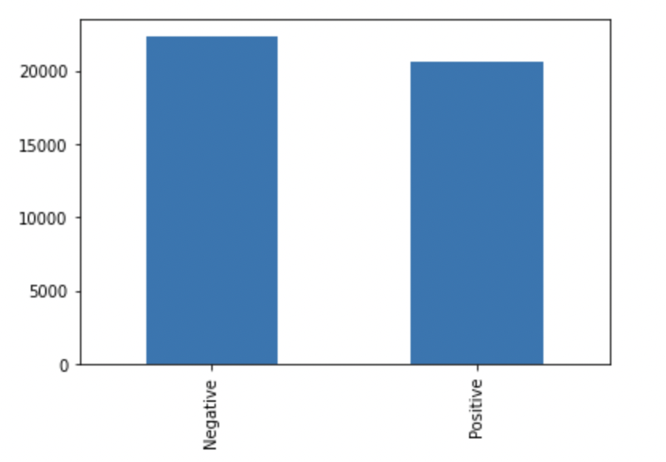
Overview of Dataset
Number of datapoints with positive and negative sentiments

Slide 8
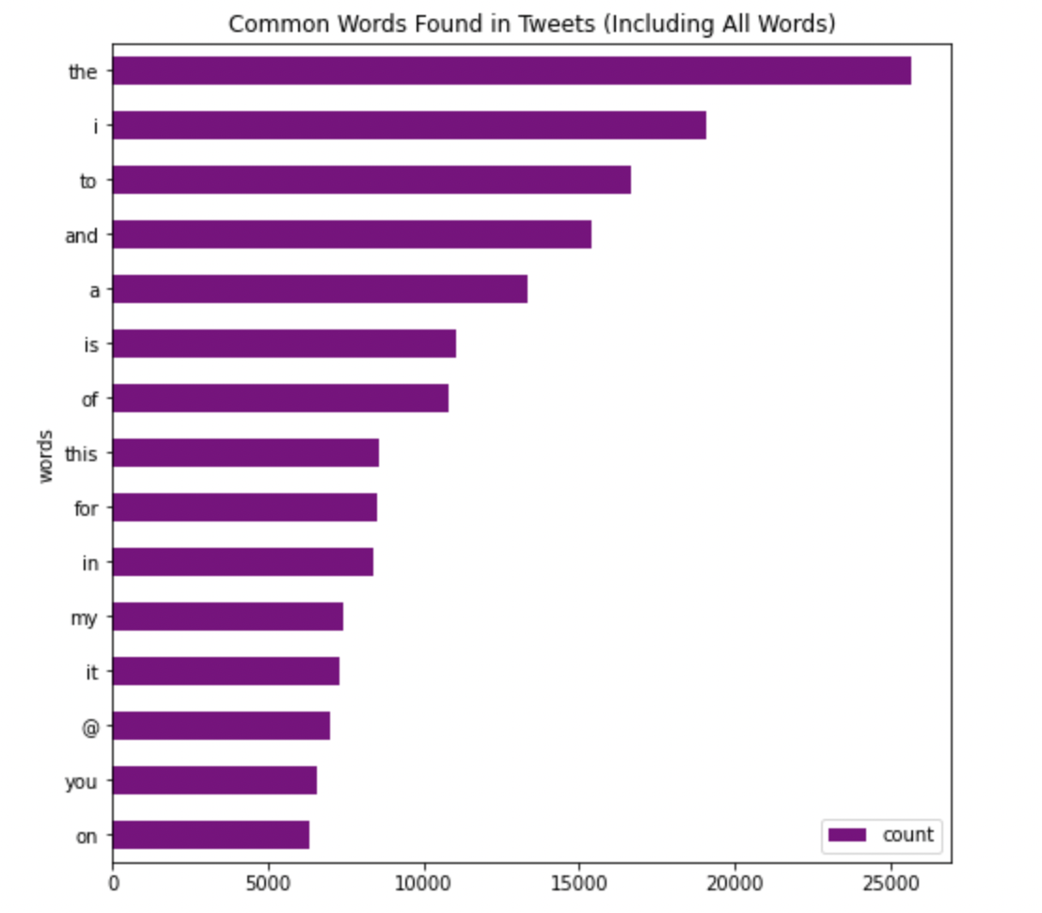
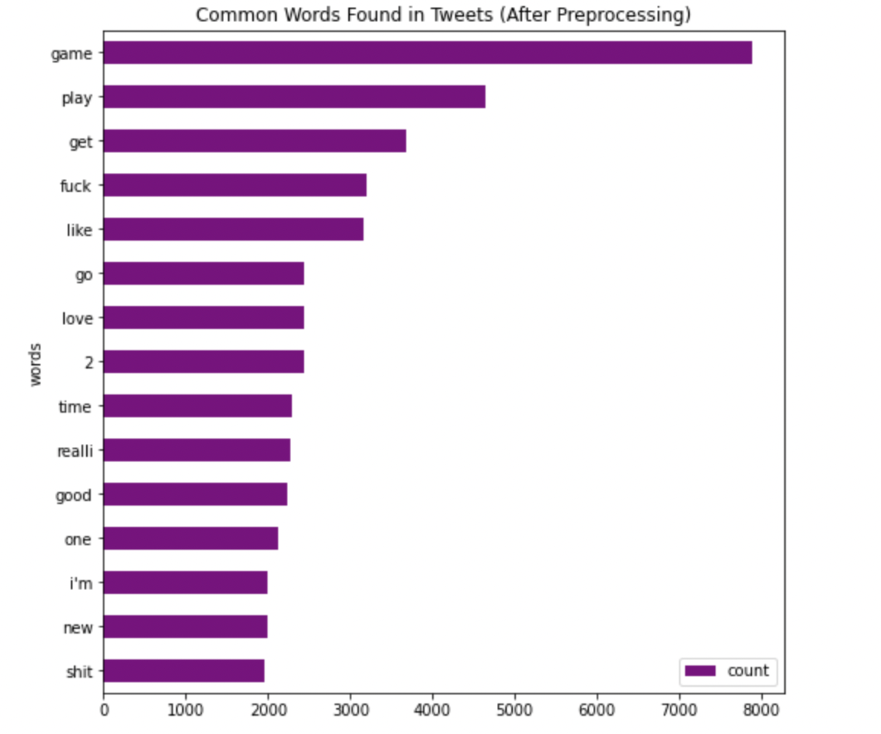
Overview of Dataset

Slide 9
SELF TRAINING
CLASSIFIER TRAINED ON SMALL AMOUNT OF LABELLED DATA
UNLABELLED DATA IS PREDICTED
PREDICTED LABELS USED FOR TRAINING
CLASSIFIER IS RE-TRAINED
USES IT’S OWN PREDICTION TO TEACH ITSELF
UNLEARN WHEN PREDICTION CONFIDENCE DROPS BELOW A THRESHOLD
UNLABELLED DATA
LABELLED DATA
TRAIN
PREDICT
PREDICTED DATA

Slide 10

COMPARISONS
SUPERVISED LEARNING:
LOGISTIC REGRESSION
SEMI SUPERVISED LEARNING:
SELF TRAINING
UNSUPERVISED LEARNING:
K -MEANS
PREDICTED
TP
FN
ACTUAL
FP
TN

Slide 11
Upcoming Semester Focus Areas
Co-Training method in semi supervised learning
Longest Common Subsequence
Documenting the Research

Slide 12
REFERENCES
Xiaojin Zhu (2005), Semi-Supervised Learning Literature Survey
V. Jothi Prakash , Dr. L.M. Nithya (2014), A Survey On Semi-Supervised Learning Techniques, International Journal of Computer Trends and Technology (IJCTT) – volume 8 number 1– Feb 2014
Xiangli Yang, Zixing Song, Irwin King, A Survey on Deep Semi-supervised Learning
Subhabrata Mukherjee, Sentiment Analysis (2012), https://www.researchgate.net/publication/236203597_Sentiment_Analysis_A_Literature_Survey/link/00b7d51c746a1c5aab000000/download

